Slide 1
Responsive Blog Website
Submitted in the partial fulfillment for the award of the degree of
BACHELOR OF ENGINEERING
IN
Computer science with a specialization in
DevOps
Submitted by:
Aditi Pandey(22BDO10031)
Km Ayushi(22BDO10055)
Under the Supervision of:
Rakesh Thakur(E17641)
Department of AIT-CSE
DISCOVER . LEARN . EMPOWER

Slide 2


Responsive Blog Website
This presentation explores the development of a responsive blog website that provides an engaging user experience across various devices.

Slide 3


Aim and Objectives
1
User-Centric Approach
2
Seamless Navigation
The primary aim is to create a user-friendly blog platform that caters to diverse user needs and preferences.
The website should offer smooth navigation, intuitive search functionality, and easy access to relevant content.
3
Visual Appeal
4
Cross-Device Compatibility
A visually appealing design is essential for enhancing user engagement and attracting a wider audience.
The website must adapt seamlessly to different screen sizes and resolutions, ensuring optimal viewing on desktops, laptops, tablets, and smartphones.

Slide 4


Methodology
1
User Research
Understanding user requirements and preferences through surveys, interviews, and user testing.
2
Design Phase
Creating wireframes, mockups, and prototypes to visualize the website's layout and functionality.
3
Development
Building the website using HTML, CSS, and JavaScript, incorporating responsive design principles for optimal device compatibility.
4
Testing and Optimization
Thorough testing across various devices and browsers to ensure functionality, responsiveness, and performance.

Slide 5



Frontend Technologies
HTML
CSS
The foundation of the website, defining the structure and content.
Styling the website to create a visually appealing and user-friendly experience.
JavaScript
React JS
Adding interactivity and dynamic functionality to the website.
A popular JavaScript library used to build interactive user interfaces.

Slide 6
Backend Technologies
Node.js
A JavaScript runtime environment that provides a powerful platform for backend development.

Slide 7

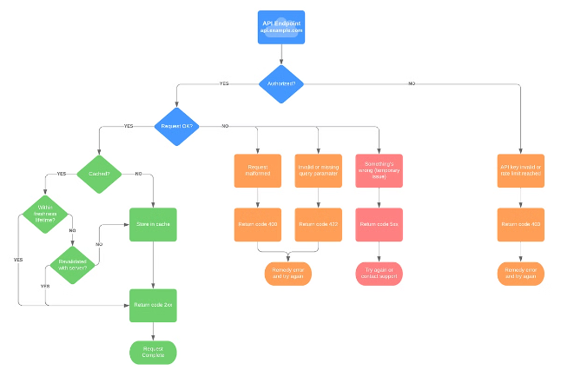


APIs and Database
RESTful APIs
To connect the frontend and backend, enabling data exchange and communication.
Database
To store and manage data effectively, providing a secure and reliable system for storing user information, blog posts, and comments.

Slide 8


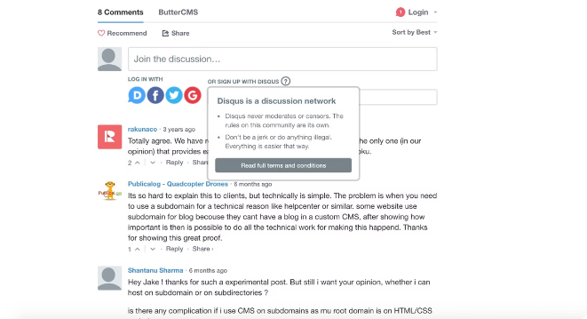


User Interaction and Engagement
Commenting System
A user-friendly commenting system allowing users to engage with the content and each other.
Likes and Reactions
Allowing users to express their appreciation for the content, fostering community engagement.
Social Sharing
Enabling users to share content on social media platforms, expanding reach and engagement.

Slide 9

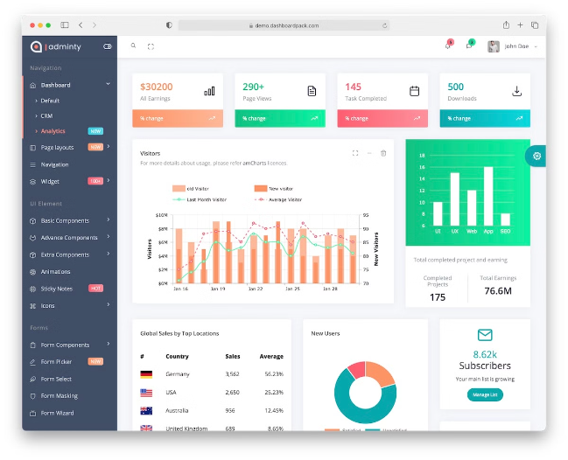
Preliminary Results
Feature
Status
Responsive Design
Completed
Navigation Menu
Implemented
Content Management System (CMS)
In Progress
Search Functionality
To Be Implemented
Social Media Integration
Planned

Slide 10
Clarity of Problem Definition
Challenges
Solutions
Outcomes
The initial challenge was to ensure that the website would provide a consistent and enjoyable user experience across different devices.
The solution involved implementing responsive design principles, using flexible layouts and CSS media queries to adapt the website's layout and content based on the device's screen size.
The website's responsiveness ensures that users can access and navigate the blog content easily on any device, regardless of their screen size.

Slide 11


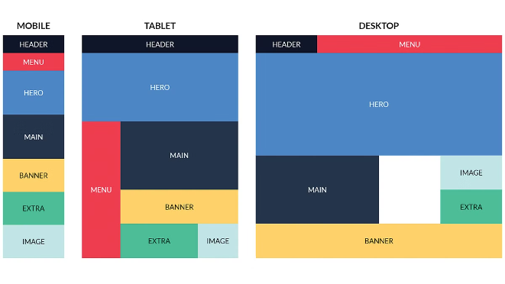



Block Diagram
User Input
Users interact with the website through various devices, including desktops, laptops, tablets, and smartphones.
Responsive Design Engine
The website uses CSS media queries to detect the user's device and dynamically adjust the layout and content to provide an optimal viewing experience.
Content Delivery
The website delivers relevant content and functionalities based on the detected device, ensuring a seamless user experience.
User Feedback
User feedback is collected through analytics and usability testing to further improve the website's responsiveness and user experience.

Slide 12


Operating Principle
The website operates on a responsive design principle. This means that the website's layout and content adapt to different screen sizes and resolutions. This is achieved through CSS media queries, which allow the website to apply different styles based on the device's screen width.

Slide 13





Future Goals
Enhanced Analytics
Improved Search
Implementing advanced analytics tools to track user behavior, website performance, and user engagement.
Improving the search functionality to enable users to easily find relevant content within the website.
Mobile Optimization
Accessibility
Further optimizing the website for mobile devices, ensuring a smooth and engaging user experience.
Enhancing the website's accessibility to ensure that all users, regardless of their abilities, can easily navigate and access the content.

Slide 14
Thank you….

